Slide 1
Title/Names
Challenges on Extension
Collecting the Data (finding data sources and verifying they were useful)
Originally gonna do zipcode but too cumbersome, stuck with community type
Reframing entire project
What key Question (Original) were answering: refer to deliv2 report (summarize)
How do areas with poor air quality compare to areas with better air quality based on different demographic characteristics, specifically:
Race/ethnicity (ACS)?
Area median income/ income
Housing density
Population density
Social vulnerability
Extension Question (New) were answering
What is the relationship between the community types (zip codes mapping to community types) in Boston and the PPI data with regards to race distributions, median income, and MBTA infrastructure?
Next Step on Extension
Further analysis on Data
Conclusions on Extension
Come up with early insights on the graphs, make some observations

Slide 2
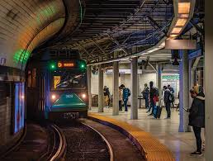


Air Quality and Transit: Team B
Project Goal:
To analyze Boston residents' health data and transport infrastructure proximity to unveil different disparities and impacts on diverse demographics.
Project Motivation:
To better understand the impact of transport infrastructure on the air quality in Boston
Members: Cathy Wang (Lead), Jackson Chiu, Sammy Terada, Jon Suarez, Naveen Vaidyamath
Sponsor: City Of Boston/MBTA, BUSPARK (Coordinate)
Notes:
Jackson

Slide 3

Overcoming Challenges and Moving Forward
- Data Consistency and Unit Understanding: We grappled with ensuring data consistency and comprehending data units, which presented significant challenges.
- Data Collection: We dedicated substantial effort to sourcing and validating data, ensuring its relevance and reliability.
- Data Limitations: Our project faced limitations due to the availability of data. For certain parameters, we encountered the absence of recent data, which posed a challenge.
- Change in Scope: Originally planning to use zip code data, we found it to be cumbersome. Consequently, we opted for a different approach by focusing on community types.
- Project Reframing: We made the strategic decision to reframe the entire project to better align with our goals and resources.
Notes:
Jackson

Slide 4
Extension Question: What is the relationship between the community types (zip codes mapping to community types) in Boston and the PPI data with regards to race distributions, median income, and MBTA infrastructure?
Notes:
Sammy

Slide 5
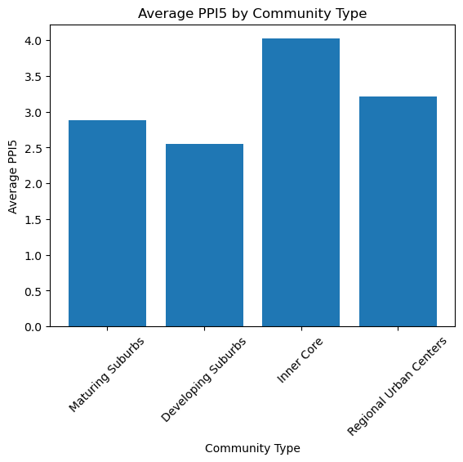
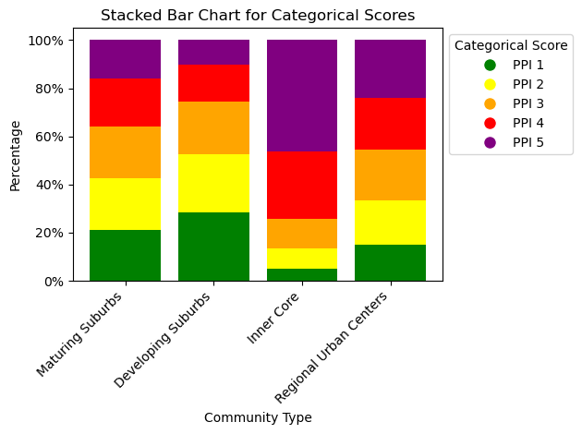
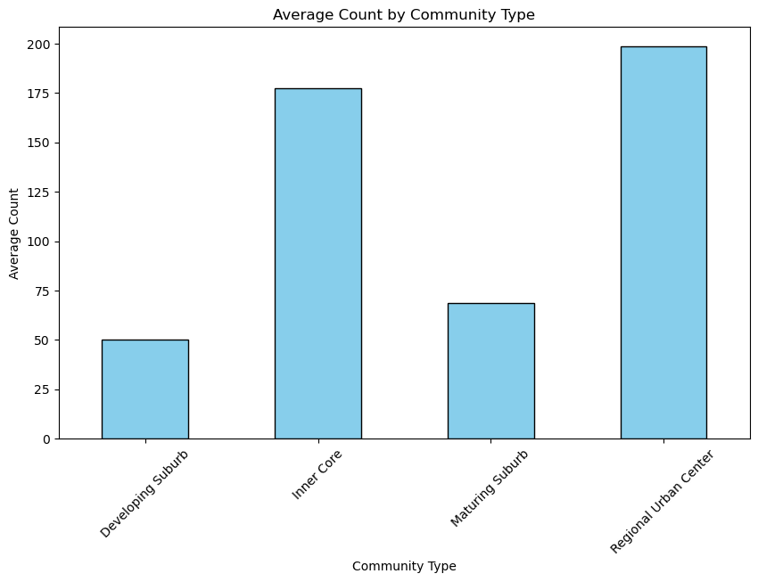
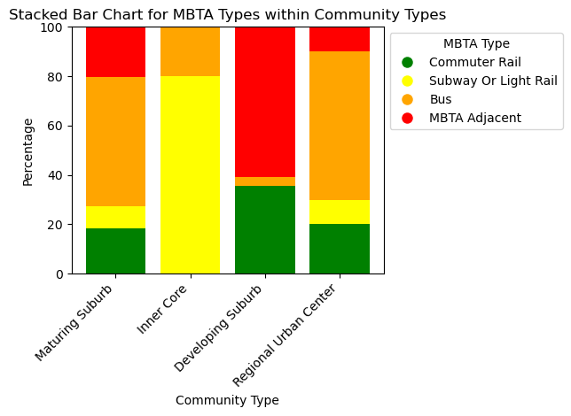
Notes:
Sammy

Slide 6
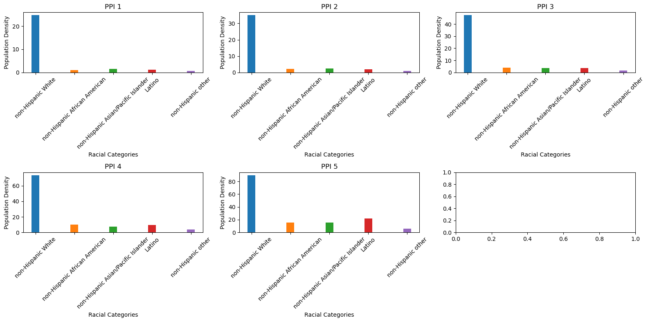
Notes:
Sammy

Slide 7
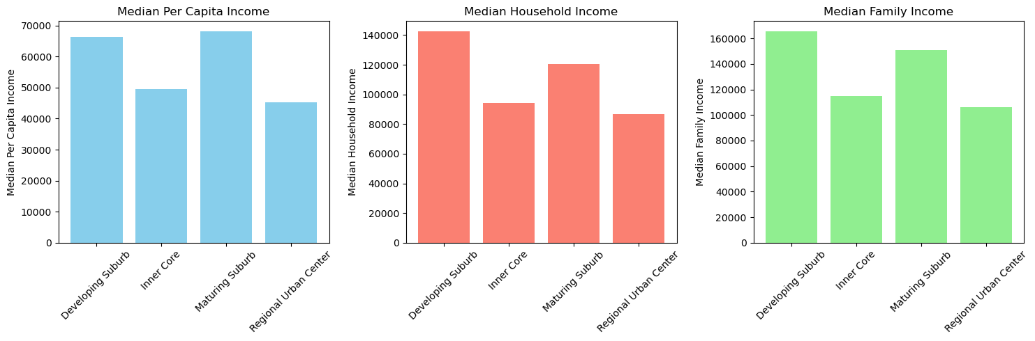
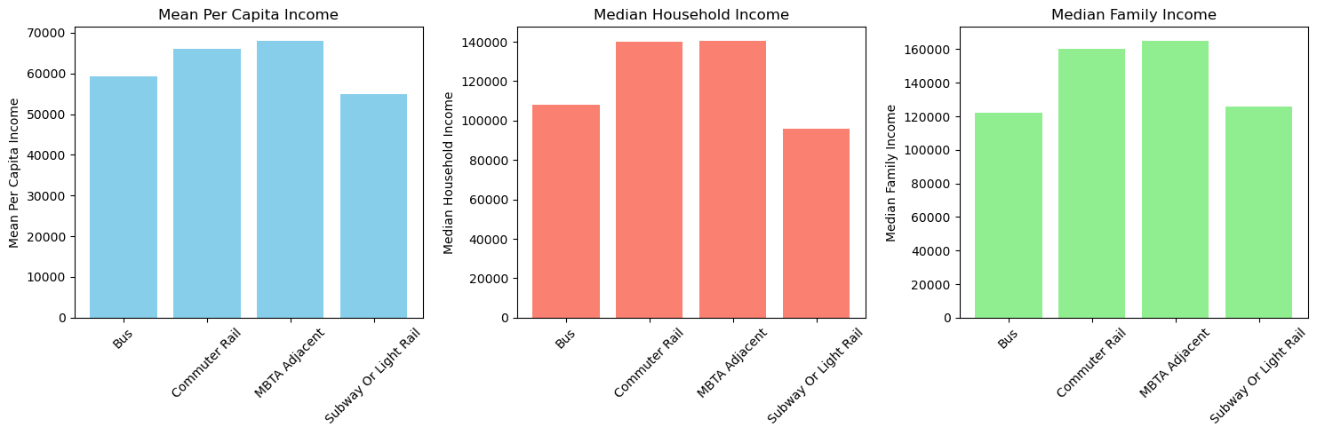
Notes:
Jon/Sammy

Slide 8
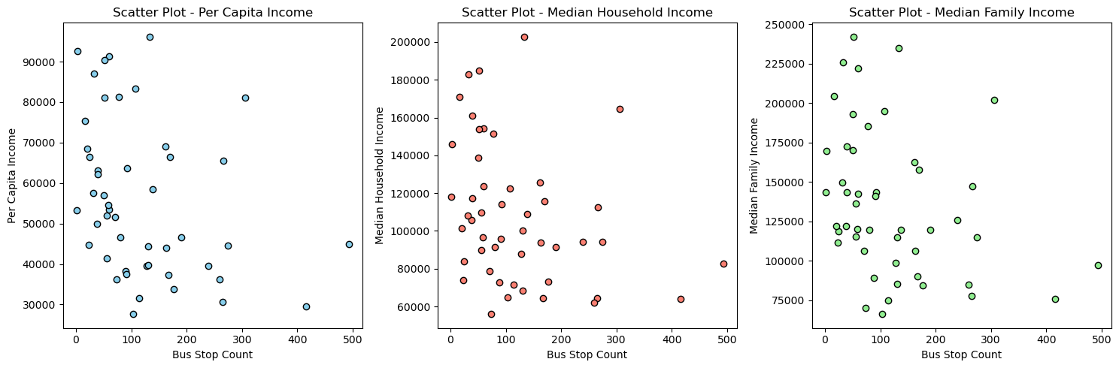
Notes:
Jon/Sammy

Slide 9
Base Question: How do areas with poor air quality compare to areas with better air quality based on different demographic characteristics, specifically:
Race/ethnicity
Area Median Income
Housing density
Population density
Social vulnerability
Notes:
Naveen

Slide 10
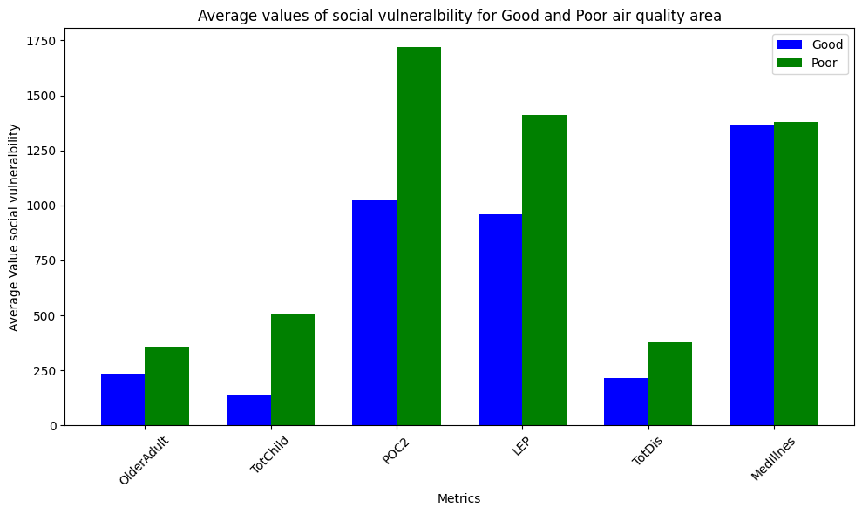
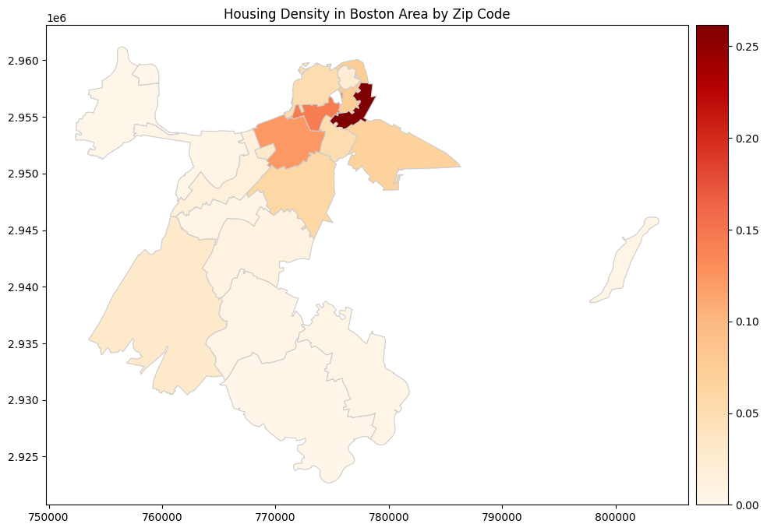
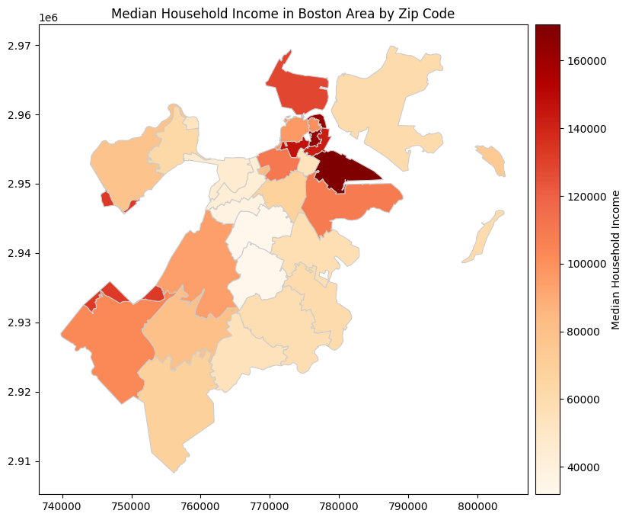
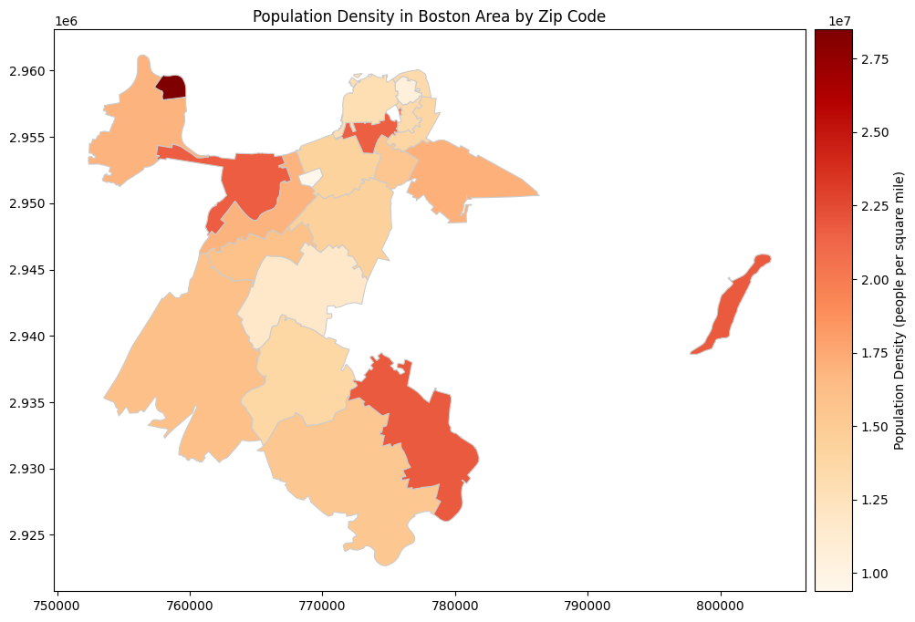
Notes:
Naveen

Slide 11

Our work
What have you done so far? (meetings, data analysis)
The team has been actively involved in meetings to discuss project progress and planning.
Data analysis has been a key focus for the team.
Each team member has taken on specific data sets and tasks related to analyzing them.
How did you divide up the work among the team?
Some of the team members worked on the construction of datasets.
Some team members made analysis based on those datasets.
What data have you used? If you collected data, how did you do that?
We used datasets involved with each municipality in Massachusetts’s number of households and population with the average/median incomes per family or per person; train stops in Massachusetts with their belonged towns; bus stops with their belonged towns.
Most of them are downloaded from online resources and sorted manually.
Notes:
Cathy

Slide 12

Current Status and Next Steps
Have you faced any additional challenges?
Adapting to last-minute project requirement changes
What limitations and assumptions did you encounter?
Mapping zip codes to locations in PPI data proved challenging, so we focused on Boston Area community types as defined by the MAPC.
Based on early results, what are our next steps?
Collaborating with Spark staff and Professor Galletti to assess our current status and chart our project's path forward.
Perform further analysis and produce graphs for each demographic characteristic, which will be our subquestions
Notes:
Cathy

Slide 13
Individual Contributions
Sinforiano
Found MAPC datasets and made graphs from it, scraped income data from online
Jon
I help construct the extension question, got feedback from Galetti with Jackson, and collaborated with Sinforiano to figure out ways to create our dataset.
Cathy
I helped on constructing both train and bus stops in Massachusetts with their belonged cities.
Naveen
Created presentation, included shapefiles, and inspected findings on housing density, and population density
Jackson
Took part in analytics for the new data and helped craft conclusions about race, area, housing, and income
Notes:
Cathy: Just say here is our individual contributions and nothing else to save time

Slide 14

Thank you

